Slide 1


Disaster Medical Operations — Part 2
CERT Basic Training
Unit 4

Slide 2
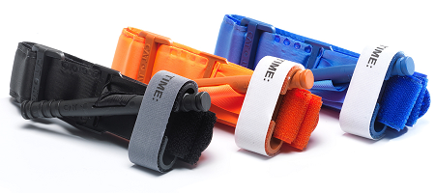
Unit 3 Review
“3 Killers”
  Airway obstruction
  Excessive bleeding (+“Stop the Bleed”)
  Shock
Sizeup (FAPAR)
START (Simple
Triage And Rapid
Treatment)

Slide 3
Unit 4 Objectives
Understand sanitation measures
How to: Head-to-toe assessments
How to: Establish a treatment area
Apply basic treatments to injuries
Notes:
2

Slide 4
Unit Topics
Public Health Considerations
Functions of Disaster Medical Operations
Establishing Medical Treatment Areas
Conducting Head-to-Toe Assessments
Treating Burns
Wound Care
Treating Fractures, Dislocations, Sprains, and Strains
Nasal Injuries
Treating Cold-Related Injuries
Treating Heat-Related Injuries
Bites and Stings
Notes:
3

Slide 5
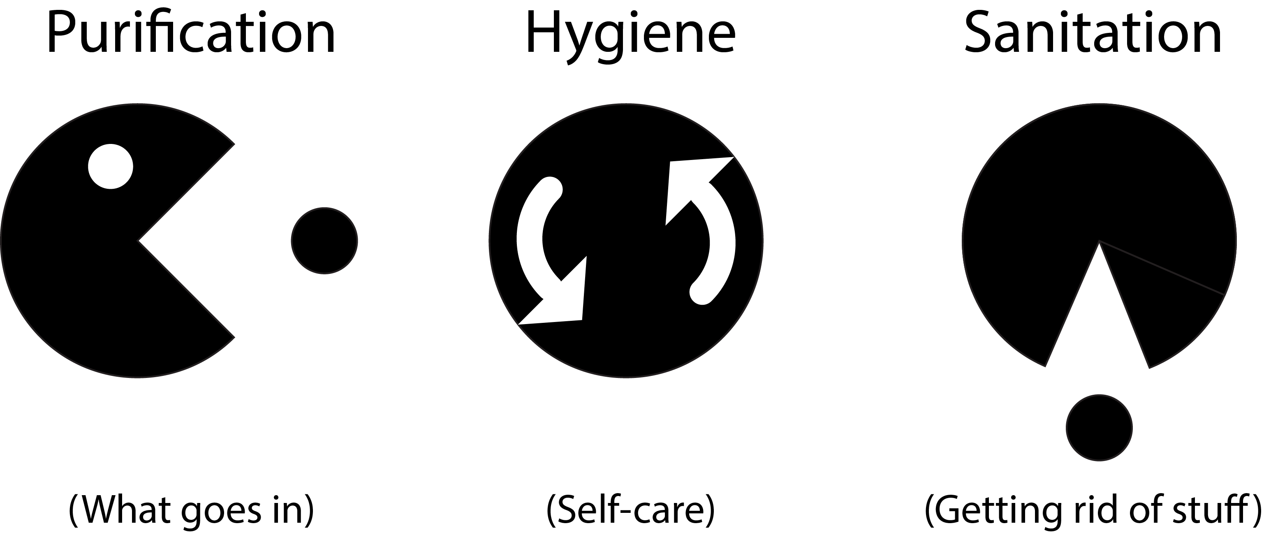
Public Health Considerations
Preventing spread of disease by:
(+ wearing PPE throughout)

Slide 6
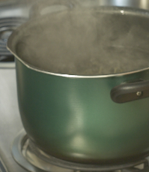
Purification
Boil water for 1 minute (let cool)
Water purification tablets
Non-perfumed liquid bleach
  8 drops/gal of water
  16 drops/gal if water is cloudy
  Let stand for 30 minutes
  before use

Slide 7
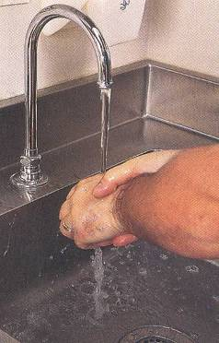
Hygiene
Wash hands frequently
Wear non-latex exam gloves
Wear N95 mask and goggles
Keep dressings sterile
Avoid contact with body fluids
  “If it is warm, wet, and not yours,
  don’t touch it!”

Slide 8
Sanitation
Control disposal of bacterial sources
Put waste products in plastic bags
  Tie off bags and mark them as medical waste
Bury human waste

Slide 9
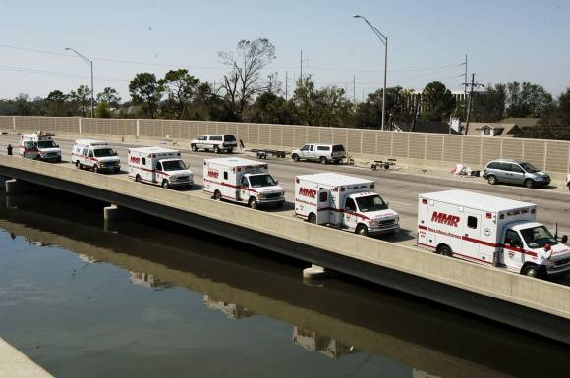
Functions of Disaster Medical Operations
Triage
Treatment
Transport
Morgue
Supply

Slide 10
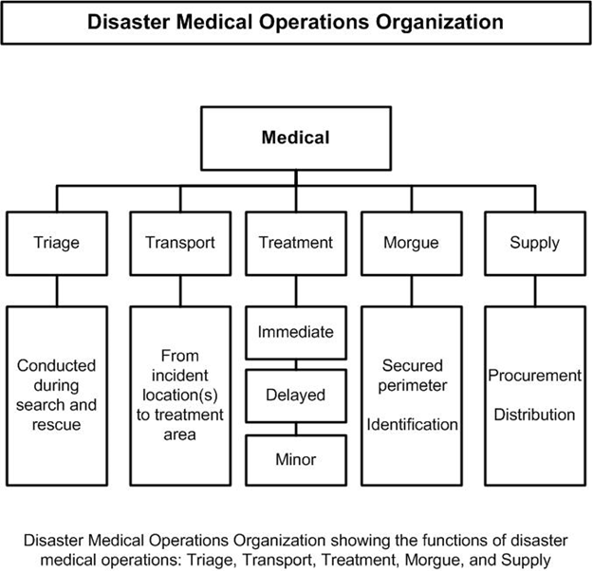
Disaster Medical Operations Organization

Slide 11
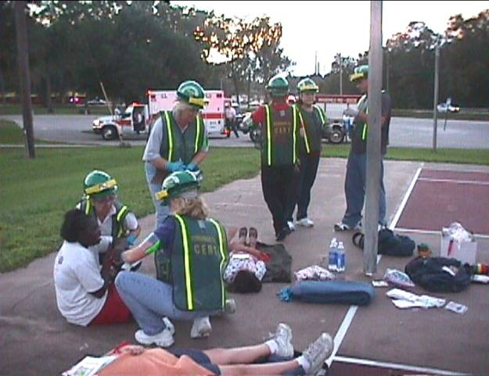
Establish a Medical Treatment Area
Select site and set up treatment area as soon as injured victims are confirmed
When determining best location(s) for treatment area, consider:
  Safety of rescuers and victims
  Most effective use of resources

Slide 12
Most Effective Use of CERT Resources
To help meet the challenge of limited resources, CERT may need to establish:
  Decentralized medical treatment location (more than one location)
  Centralized medical treatment location (one location)
Notes:
11

Slide 13
Treatment Area Layout
Four treatment areas:
“I” for Immediate
“D” for Delayed
“M” for Minor
“DEAD” for morgue

Slide 14

Victim Placement: Why head to toe?
Notes:
13

Slide 15
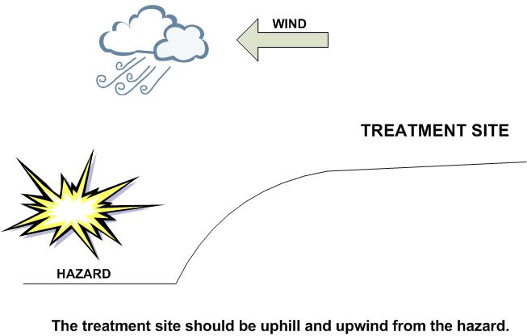
Treatment Area Site Selection
The site selected should be:
  In a safe area, free of hazards and debris
  Upwind, uphill, and upstream (if possible) from hazard zone(s)
  Accessible by transportation vehicles
  Expandable
Notes:
14

Slide 16
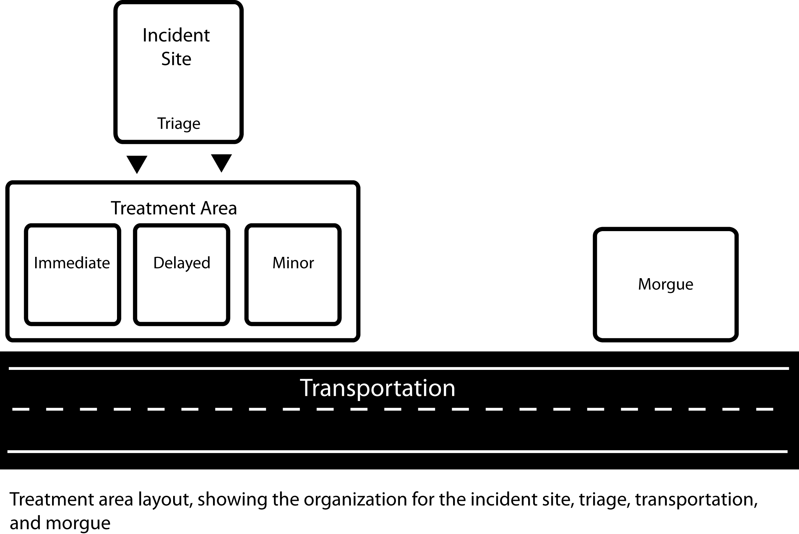
Treatment Area Layout
Notes:
15

Slide 17
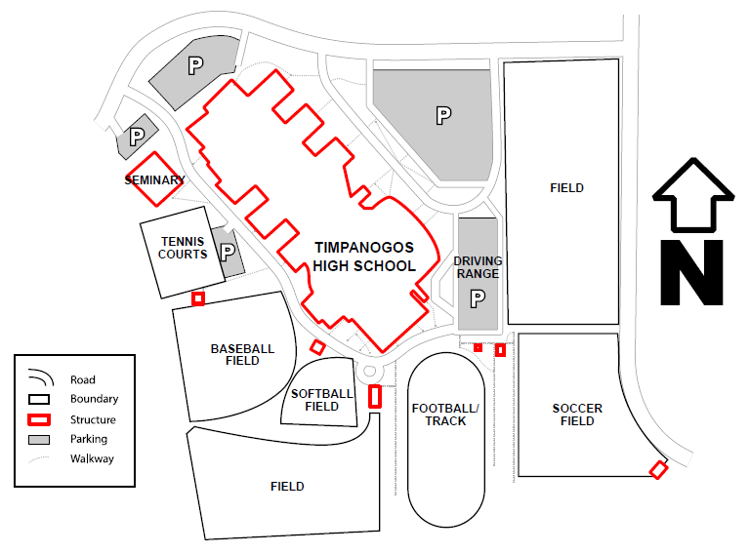

Try it out: Plan Treatment Areas
Consider:
Casualty location
Nature of disaster
Season
Weather
Wind direction
Lay of the land
Vehicle access
Notes:
16

Slide 18
Where and When
Light damage: assess in place
Moderate damage: move to treatment area first
Assess and tag everyone
Both verbal and hands on

Slide 19

Treatment Area Organization
Assign treatment leader to each treatment area
Document thoroughly (VTAR, Form #5)
  Available identifying information
  Description (age, sex, body build, estimated height)
  Clothing
  Injuries
  Treatment
  Transfer location
  Times

Slide 20
Conducting Head-to-Toe Assessment
Pay careful attention
Look, listen, and feel (DCAP-BTLS)
Check own hands for patient bleeding
If you suspect a spinal injury in unconscious victims, treat accordingly
Check PMS in all extremities
(Pulse, Movement, Sensation)
Look for medical identification

Slide 21
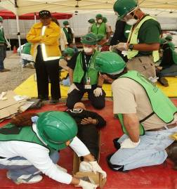
Head-to-Toe Assessment
Objectives of head-to-toe assessment:
  Determine extent of injuries
  Determine type of
  treatment needed
  Document injuries

Slide 22
Head-to-Toe Assessment Simplified
DCAP-BTLS
(Hard-to-remember acronym with unfamiliar terminology)

Slide 23
Head-to-Toe Assessment Simplified
Deformities
Contusions=Bruises
Abrasions=Scrapes
Punctures
Burns
Tenderness
Lacerations=Cuts or tears
Swelling

Slide 24
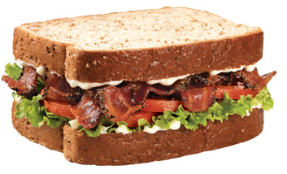
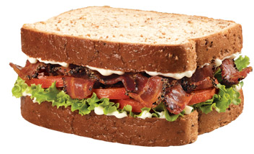
Head-to-Toe Assessment Simplified
PAC’D-BLTS
(Easier. Also, yummy.)

Slide 25
Head-to-Toe Assessment Simplified
Cuts or tears
Punctures
Scrapes
Bruises
Deformities
Swelling
Burns
Tenderness
Bleeding,
external + internal
Group injury types
(by symptom,
not specific injury)
Misshapen, misaligned
Charred/blistered

Slide 26
Head-to-Toe Assessment Simplified
Search for the “Bees:”
Bleeding & Bruises: Scrapes, cuts, punctures, discoloration, (tenderness)
Broken Bones & Bumps: Misshapen body parts, swelling, protrusions, (tenderness)
Burns/Blisters: Skin discoloration, blistering, charring, (tenderness)
Tenderness will reveal itself with assessment
(if victim is conscious)

Slide 27

Head-to-Toe Assessment Simplified
Use your
senses
Looking: Look for blood, discoloration, misshapen bones, blisters, pupil dilation.
Feeling: Feel for bumps and breaks underneath clothing. Thin exam gloves are best.
Listening: Listen for coughing and breathing.
Talking: Encourage the patient to tell you when something hurts. Tell them what you are doing.

Slide 28
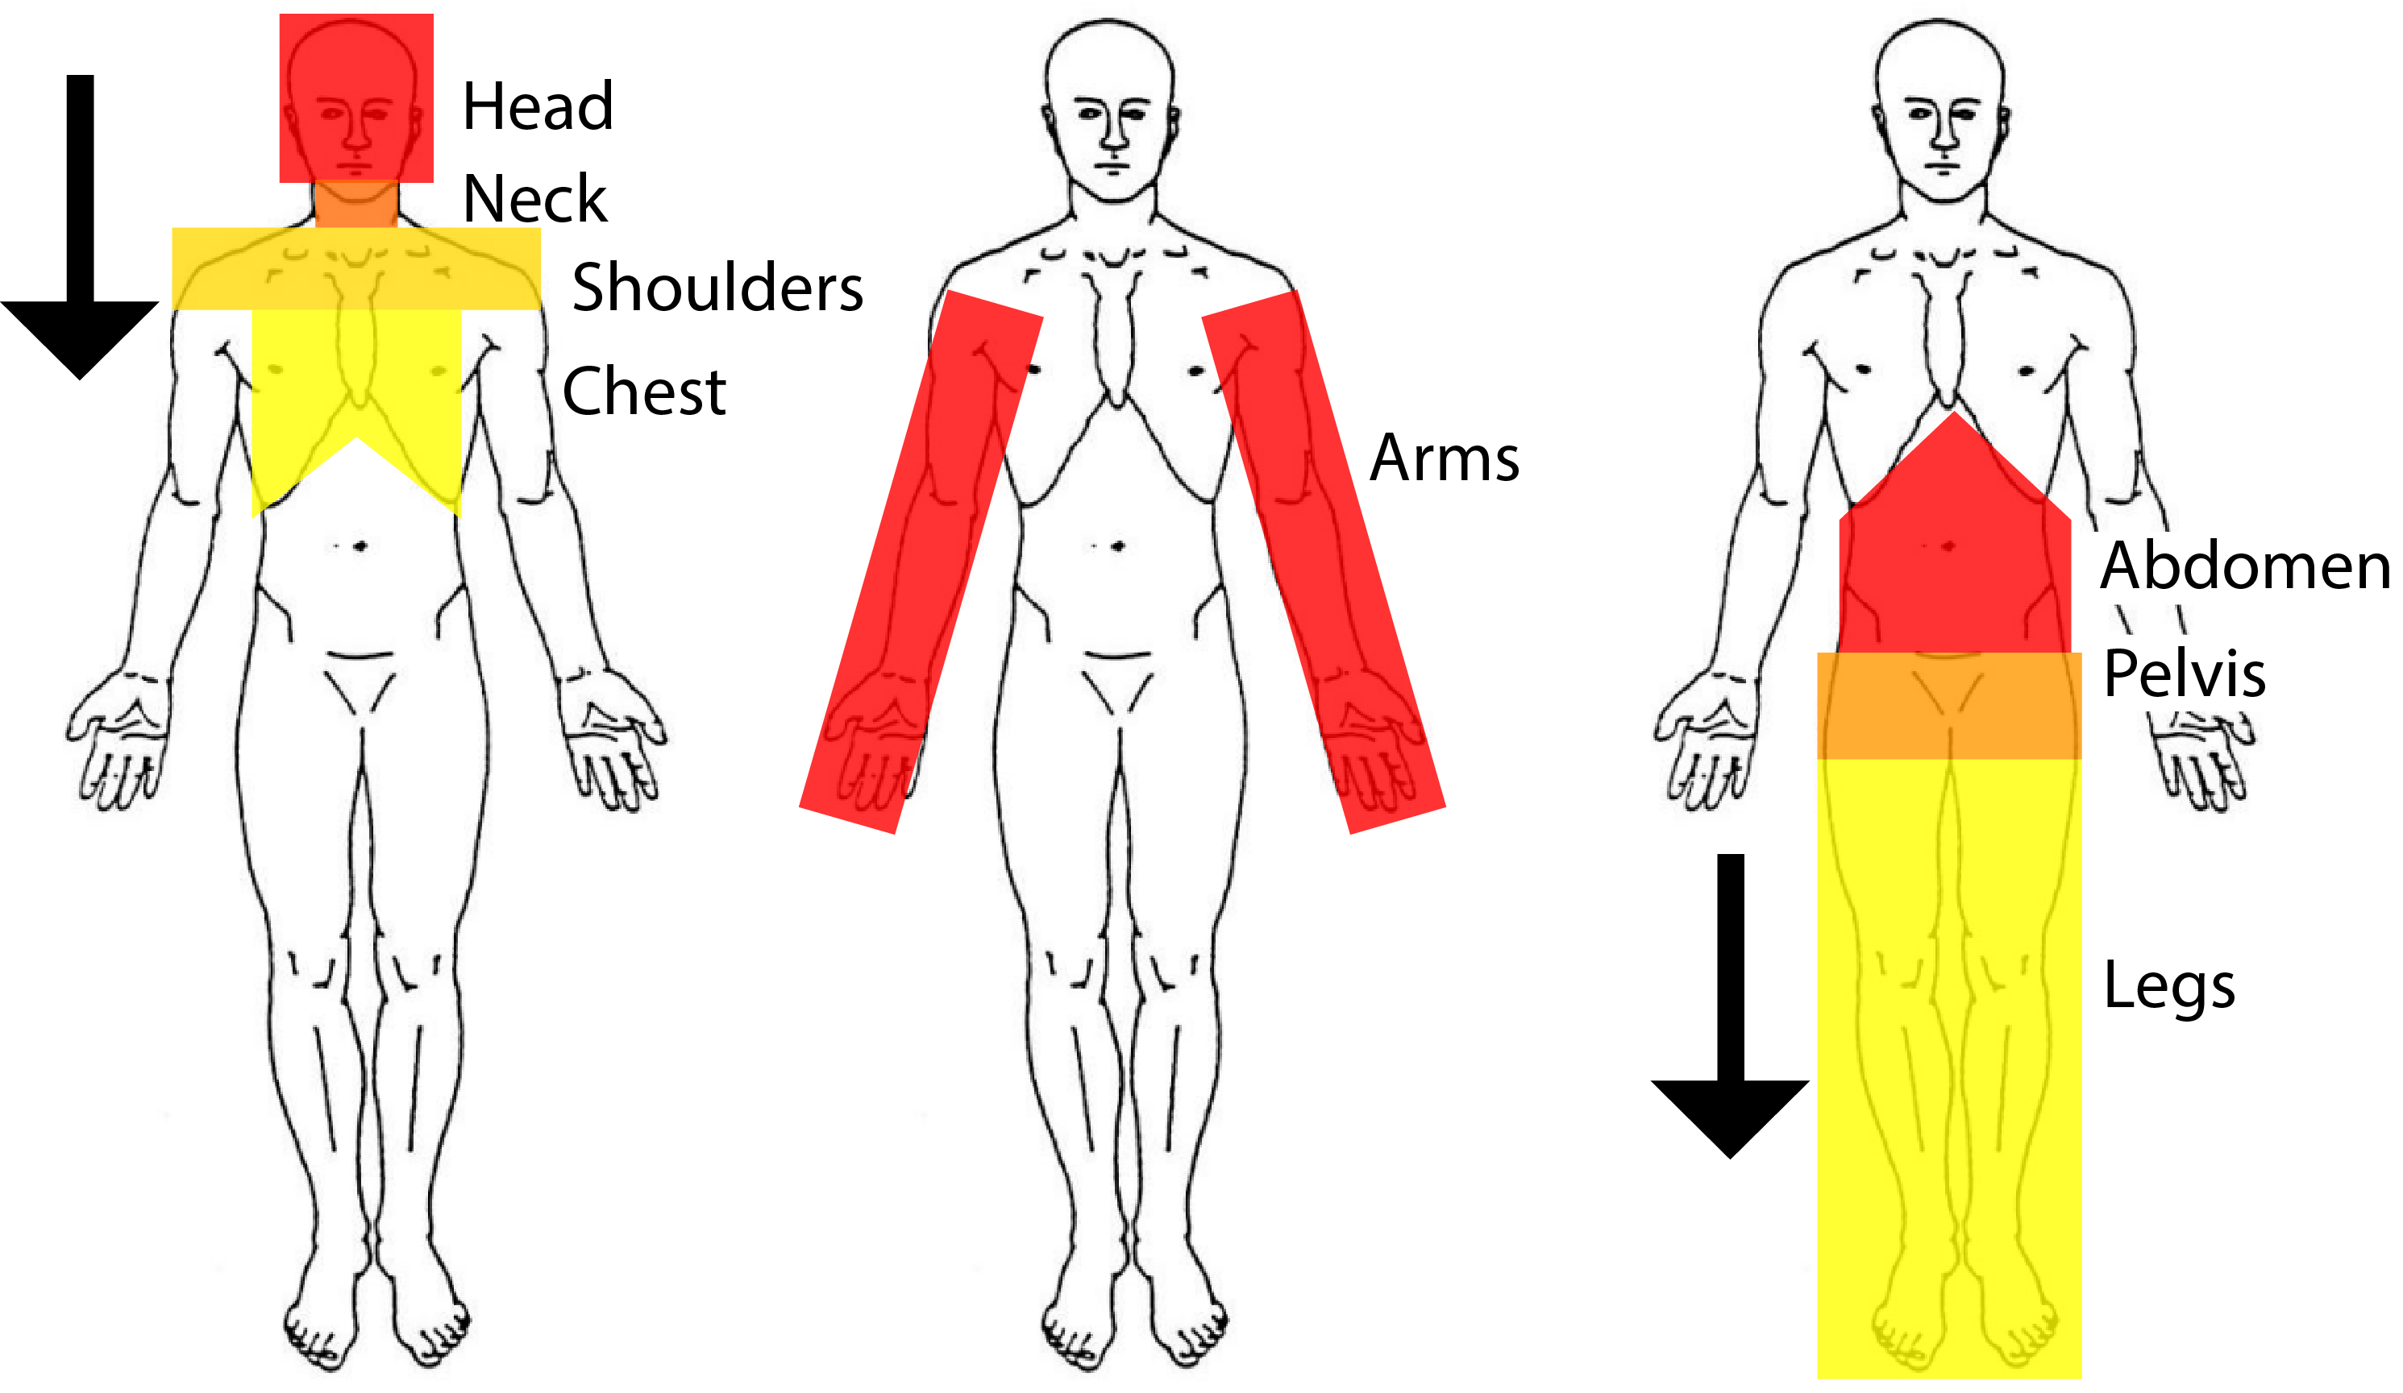
Order of Assessment

Slide 29
Closed-Head, Neck, Spinal Injuries
Do no harm
  Minimize movement of head and neck
Keep spine in straight line
Stabilize head

Slide 30
Closed-Head, Neck, Spinal Injuries (Cont)
Signs of closed-head, neck and spinal injuries:
Change in consciousness
Inability to move one or more body parts
Severe pain or pressure in head, neck or back
Tingling or numbness in extremities
Difficulty breathing or seeing
Heavy bleeding, bruising, or deformity of the head or spine
Blood or fluid in the nose or ears
Bruising behind the ears
“Raccoon” eyes (bruising around eyes)
“Uneven” pupils
Seizures
Nausea or vomiting
Victim found under collapsed building material or heavy debris

Slide 31

Video: Head-to-Toe Assessment

Slide 32


Video: Head-to-Toe Assessment
5:44

Slide 33
Exercise: Head-to-Toe Assessment

Slide 34


Slide 35
Treating Burns
Conduct thorough sizeup
Treat with first aid
  Cool burned area
  Cover with sterile cloth to reduce risk of infection

Slide 36
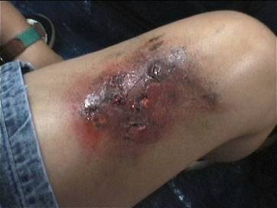
Burn Severity
Factors that affect burn severity:
  Temperature of burning agent
  Period of time victim exposed
  Area of body affected
  Size of area burned
  Depth of burn

Slide 37
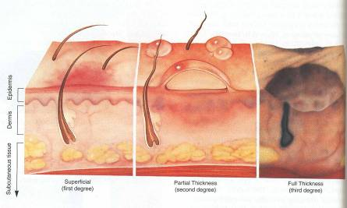
Burn Classifications
Superficial: epidermis
Partial Thickness: dermis and epidermis
Full Thickness: subcutaneous layer and all layers above

Slide 38
Burn Treatment: DOs
When treating a burn victim, DO:
  Cool skin or clothing if they are still hot
  Cover burn loosely with dry, sterile dressings to keep air out, reduce pain, and prevent infection
  Elevate burned extremities
Notes:
37

Slide 39
Burn Treatment: DON’Ts
When treating a burn victim, DO NOT:
  Use ice
  Apply antiseptics, ointments, or other remedies
  Remove shreds of tissue, break blisters, or remove adhered particles of clothing
Notes:
38

Slide 40

Treatment for Chemical Burns
Remove cause of burn + affected clothing/jewelry
If irritant is dry, gently brush away as much as possible
  Always brush away from eyes, victim, and you
Flush with lots of cool running water
Apply cool, wet compress to relieve
pain
Cover wound loosely with
dry, sterile or clean dressing
Treat for shock if appropriate

Slide 41
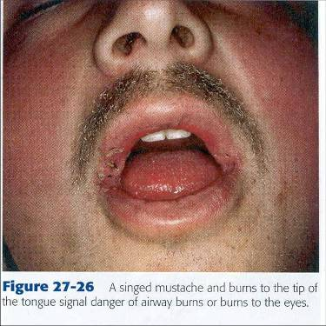
Inhalation Burns Signs and Symptoms
Sudden loss of consciousness
Evidence of respiratory distress or upper airway obstruction
Soot around mouth/nose
Singed facial hair
Burns around face/neck
Notes:
40

Slide 42
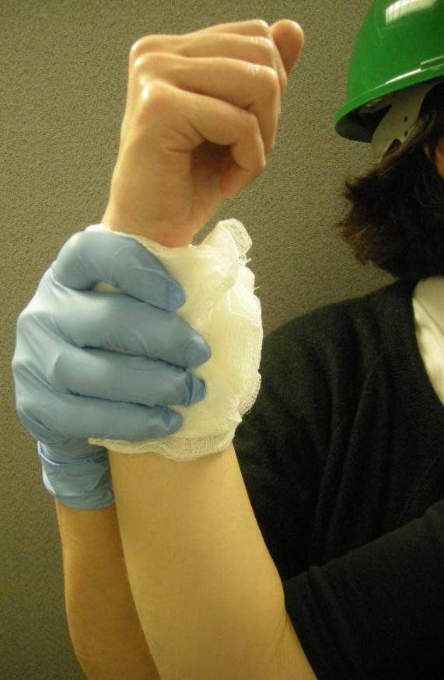
Wound Care
Control bleeding
Clean wound
Apply dressing and bandage
Notes:
41

Slide 43
Common Injuries After A Disaster
Lacerations
Amputations and impaled objects
Fractures, dislocations, sprains/strains
Nasal injuries
Cold-related injuries
Heat-related injuries
Insect bites/stings

Slide 44
Cleaning and Bandaging Wounds
Clean by irrigating with clean, room temperature water
  NEVER use hydrogen peroxide
  Irrigate but do not scrub
Apply dressing and bandage
  Dressing applied directly to wound
  Bandage holds dressing in place

Slide 45
Rules of Dressing
If active bleeding:
  Redress OVER existing dressing
If no active bleeding:
  Remove bandage and dressing to flush wound
  Check for infection every 4-6 hours

Slide 46
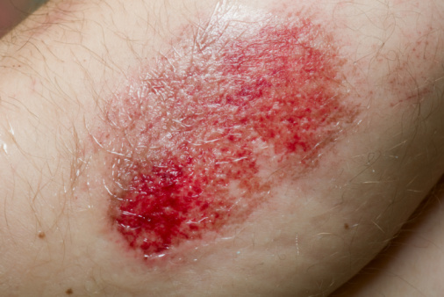
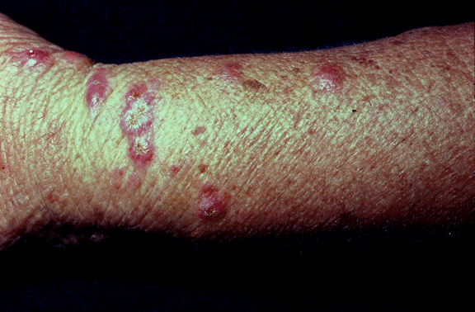
Signs of Infection
Signs of possible infection
  Swelling around wound site
  Discoloration
  Discharge from wound
  Red striations from wound site
Notes:
45

Slide 47
Amputations
Control bleeding; treat shock
If amputated body part is found:
  Save tissue parts, wrapped in clean material and placed in plastic bag
  Keep tissue parts cool, NOT directly on ice
  Keep severed part with victim
Notes:
46

Slide 48
Impaled Objects
When foreign object is impaled in patient’s body:
  Immobilize affected body part
  Do not attempt to move or remove
  Try to control bleeding at entrance wound
  Clean and dress wound, making sure to stabilize impaled object
Notes:
47

Slide 49
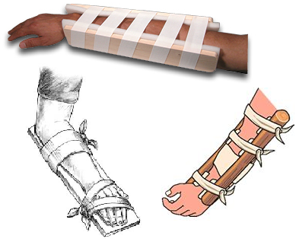
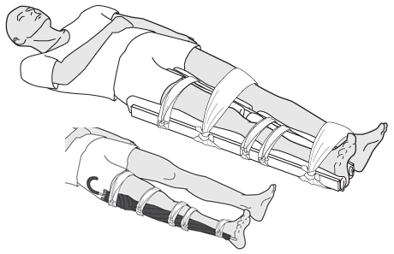
Fractures, Dislocations, Sprains, Strains
Immobilize injury and joints immediately above and below injury site
If uncertain of injury type, treat as fracture

Slide 50
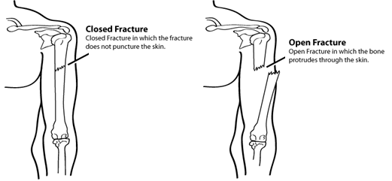
Types of Fractures
Notes:
49

Slide 51
Treating Open Fractures
Do not draw exposed bone ends back into tissue
Do not irrigate wound
Cover wound with sterile dressing
Splint fracture without disturbing wound
Place moist dressing over bone end
Notes:
50

Slide 52
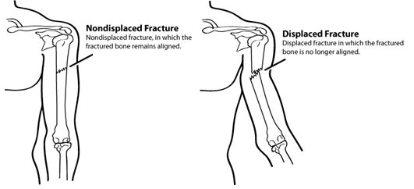
Displaced and Nondisplaced Fractures
Notes:
51

Slide 53
Dislocations
Dislocation is injury to ligaments around joint
  So severe that it permits separation of bone from its normal position in joint
Treatment
  Immobilize; do NOT relocate
  Check PMS before and after splinting/ immobilization

Slide 54
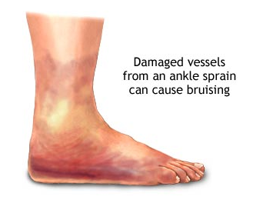
Signs of Sprain
Tenderness at site
Swelling and bruising
Restricted use
or loss of use
Notes:
53

Slide 55
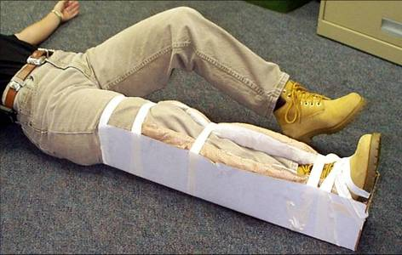
Splinting
Notes:
54

Slide 56
Splinting Guidelines
Support injured area above and below injury
Assess PMS in extremity
Splint injury in position that you find it
Don’t try to realign bones or joints
Fill voids to stabilize and immobilize
Immobilize above and below injury
After splinting, reassess PMS
Notes:
55

Slide 57
Exercise: Splinting

Slide 58
Nasal Injuries
Causes
  Blunt force to nose
  Skull fracture
  Nontrauma conditions, e.g., sinus infections, high blood pressure, and bleeding disorders
Cautions
  Large blood loss from nosebleed can lead to shock
  Actual blood loss may not be evident because victim will swallow some amount of blood

Slide 59
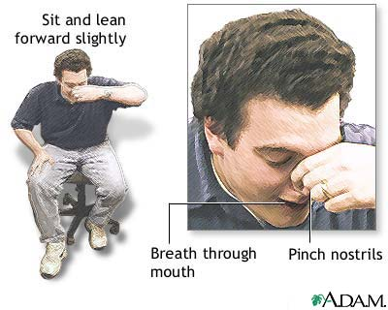
Treatment of Nasal Injuries
Control nasal bleeding:
  Pinch nostrils or put pressure on upper lip under nose
  Have victim sit with head forward, NOT back
Ensure that airway remains open
Keep victim calm
Notes:
58

Slide 60
Cold-Related Injuries
Hypothermia :
  Occurs when body’s temperature drops below normal
Frostbite:
  Occurs when extreme cold shuts down blood flow to extremities, causing tissue death
Notes:
59

Slide 61
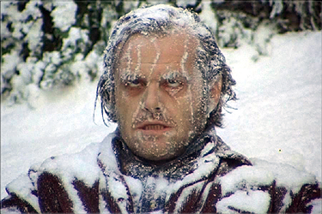
Symptoms of Hypothermia
Body temperature of
95° F or lower
Redness or
blueness of skin
Numbness and shivering
Slurred speech
Unpredictable behavior
Listlessness
Also, teenagers
Notes:
60

Slide 62
Hypothermia Treatment
Remove wet clothing
Wrap victim in blanket
Protect victim from weather
Provide food and drink to conscious victims
Do not attempt to massage to warm body
Place unconscious victim in recovery position
Place victim in warm bath
Notes:
61

Slide 63
Recovery Position
Place the victim’s arm that is nearest to you at a right angle against the ground, with the palm facing up.
Move the victim’s other arm across his or her chest and neck, with the back of the victim’s hand resting against his or her cheek.
Grab a hold of the knee furthest from you and pull it up until the knee is bent and the foot is flat on the floor
Pull the knee toward you and over the victim’s body while holding the victim’s hand in place against his or her cheek.
Position the victim’s leg at a right angle against the floor so that the victim is lying on his or her side.
If the victim is conscious, place him or her in a warm bath.

Slide 64
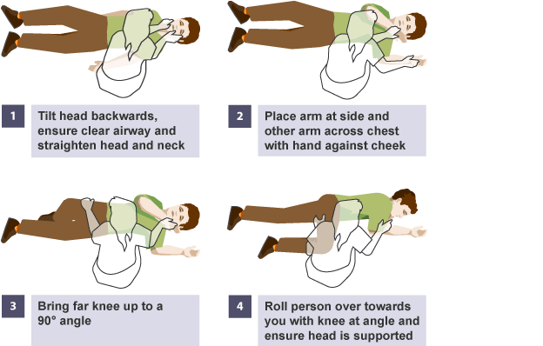
Recovery Position

Slide 65
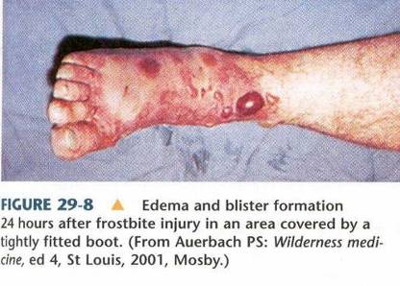
Symptoms of Frostbite
Skin discoloration
Burning or tingling sensation
Partial or complete numbness
Notes:
64

Slide 66
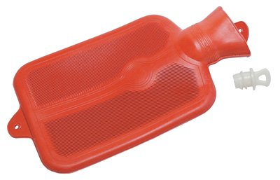
Frostbite Treatment
Immerse injured area in warm (NOT hot) water
  Warm slowly!
Do NOT allow part to re-freeze
Do NOT attempt to use
massage
Wrap affected body parts
in dry, sterile dressing
Notes:
65

Slide 67
Heat-Related Injuries
Heat cramps:
  Muscle spasms brought on by over-exertion in extreme heat
Heat exhaustion:
  Occurs when exercising or working in extreme heat results in loss of body fluids
Heat stroke:
  Victim’s temperature control system shuts down
  Body temperature rises so high that brain damage and death may result
Notes:
66

Slide 68
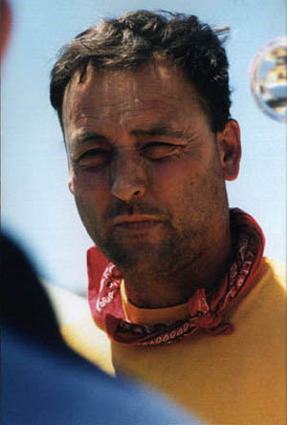
Symptoms of Heat Exhaustion
Cool, moist, pale or flushed skin
Heavy sweating
Headache
Nausea or vomiting
Dizziness
Exhaustion

Slide 69
Symptoms of Heat Stroke
Hot, red skin
Lack of perspiration
Changes in consciousness
Rapid, weak pulse and rapid, shallow breathing

Slide 70
Treatment of Heat-Related Injuries
Remove from heat to cool environment
Cool body slowly
Have the victim drink water, SLOWLY
No food or drink if victim is experiencing vomiting, cramping, or is losing consciousness
Watch closely
Notes:
69

Slide 71
Treatment for Bites/Stings
If bite or sting is suspected, and situation is non-emergency:
  Remove stinger if still present by scraping edge of credit card or other stiff, straight-edged object across stinger
  Wash site thoroughly with soap and water
  Place ice on site for 10 minutes on and 10 minutes off
  If the victim has own allergy medicine they should take it.
Notes:
70

Slide 72
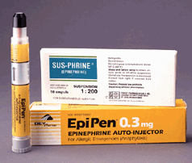
Anaphylaxis
Check airway and breathing
Calm individual
Remove constrictive clothing and jewelry
Find and help administer
victim’s Epi-pen
Watch for signs of
shock and treat
appropriately
Notes:
71

Slide 73
Unit Summary
Public health concerns related to sanitation, hygiene, and water purification
Organization of disaster medical operations
Establishing treatment areas
Conducting head-to-toe assessments
Treating wounds, fractures, sprains, and other common injuries
Notes:
72

Slide 74
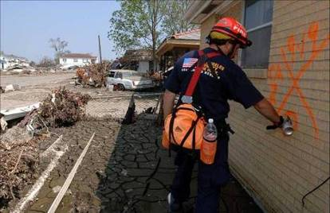
Homework Assignment
Read unit 5
Bring gear (with flashlight)
Wear loose fitting, comfortable clothing
Practice
head-to-toe
assessment on
family member
Notes:
73

